Slide 1


TEAM TECHie
Car Rental App
Instructor :- Mr. Kamal K

Slide 2
TEAM DETAILS
SOHRAB SHERGILL C0772226
NIDHI PATEL C0777186
MEET PATEL C0771681
SUMANPREET KAUR C0771694
AKWINDER KAUR C0772221

Slide 3
FUNCTIONAITIES
Select Location
Car Details
Inventory ( Static , Database not connected)
Checkout Page
All textboxes has validations *

Slide 4
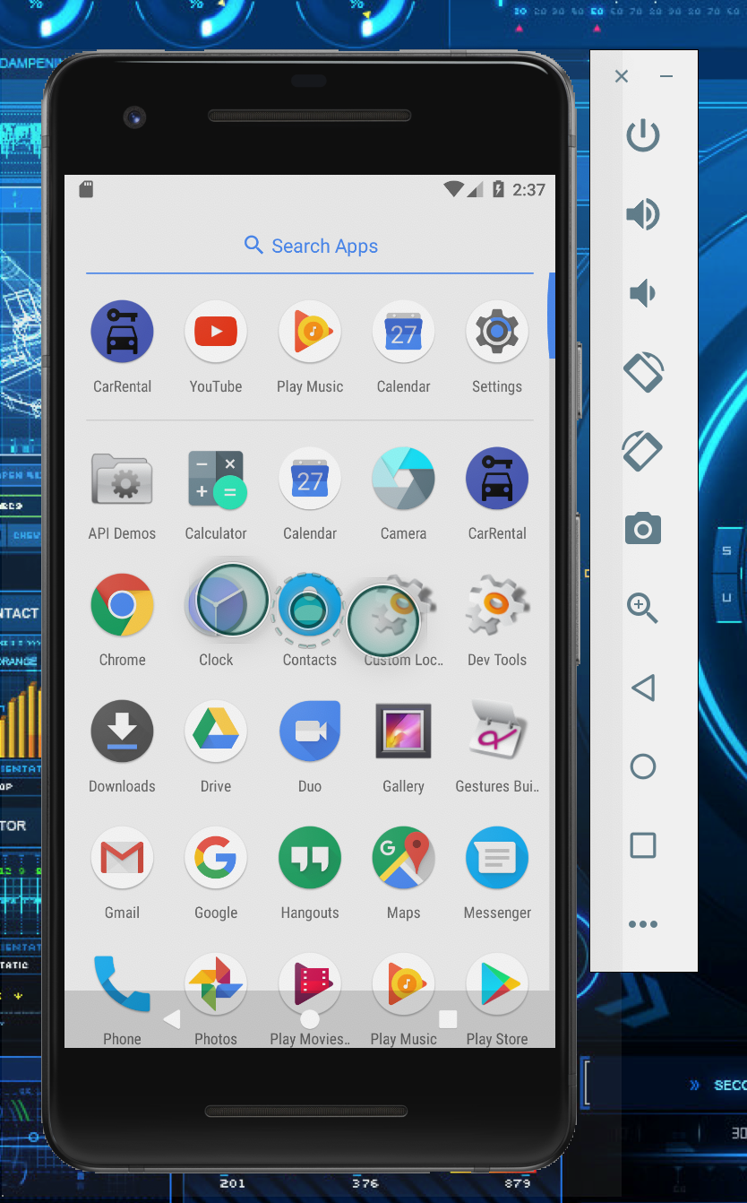
Logo

Slide 5
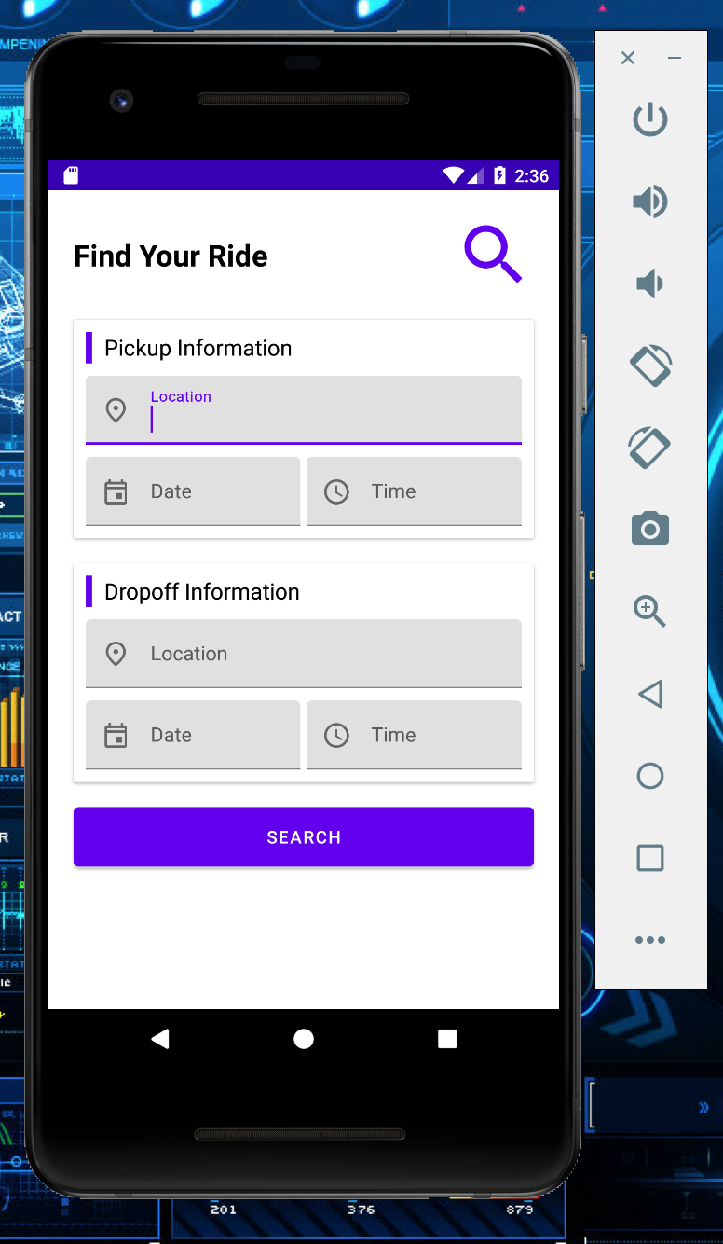
Landing Page

Slide 6
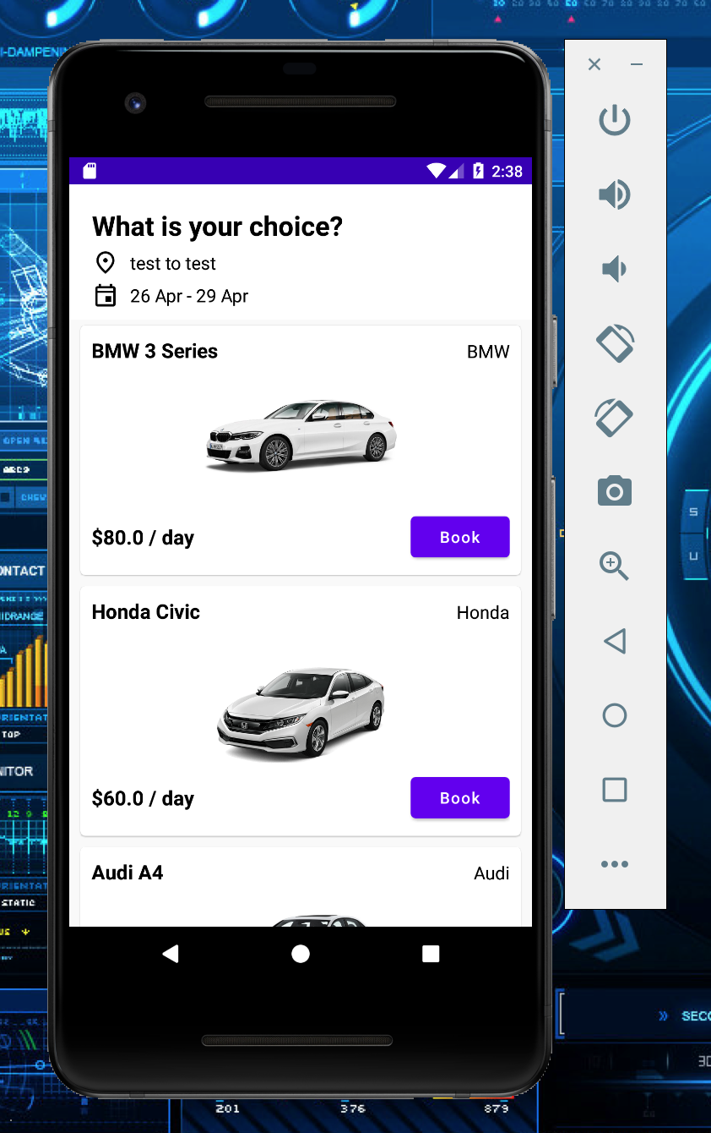
Inventory

Slide 7
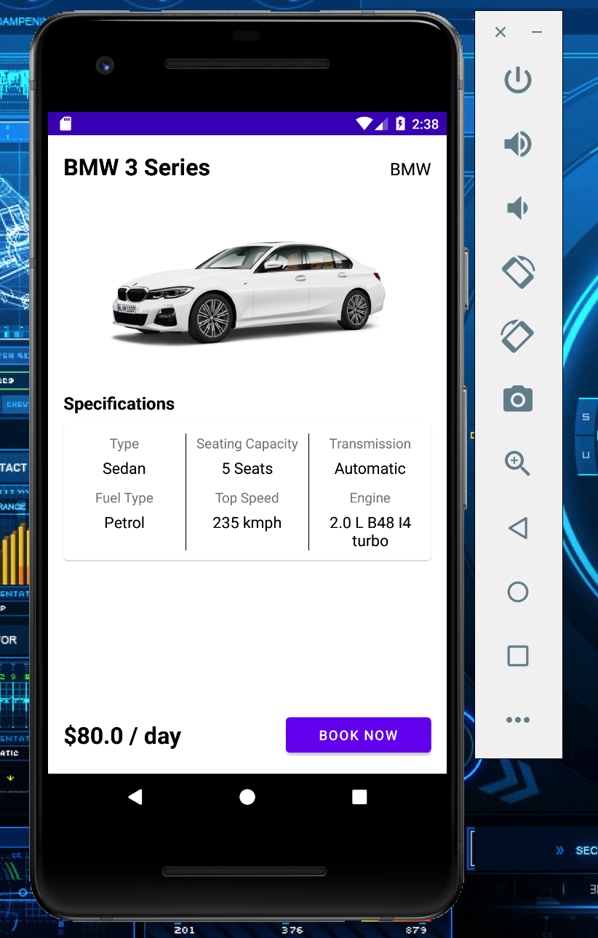
Car Details

Slide 8
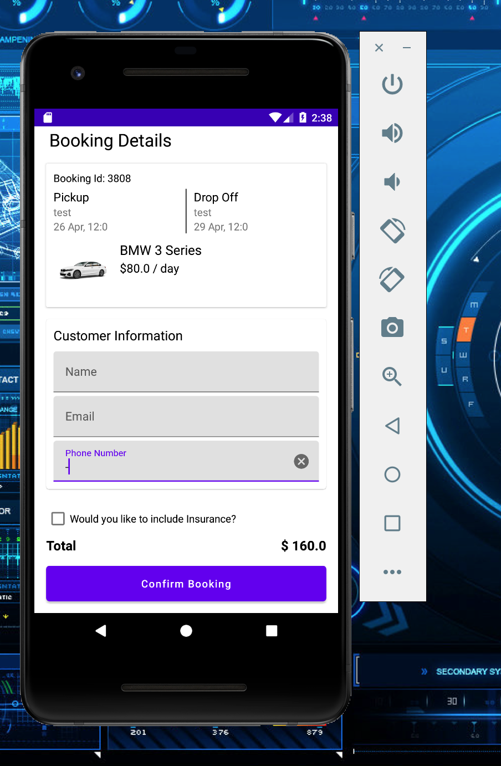
Booking

Slide 9
Adioosss

